Slide 1
APUSH Review: The Revolutionary War
Everything You Need to Know About The Revolutionary War To Succeed In APUSH

Slide 2
Events Before the War
End of Salutary Neglect
Taxes:
Sugar, Stamp, Townshend, Tea, etc.
Coercive Acts
Representation (lack of)
Want more info?
APUSH Review: Key Acts Leading to the American Revolution

Slide 3
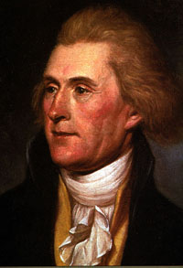
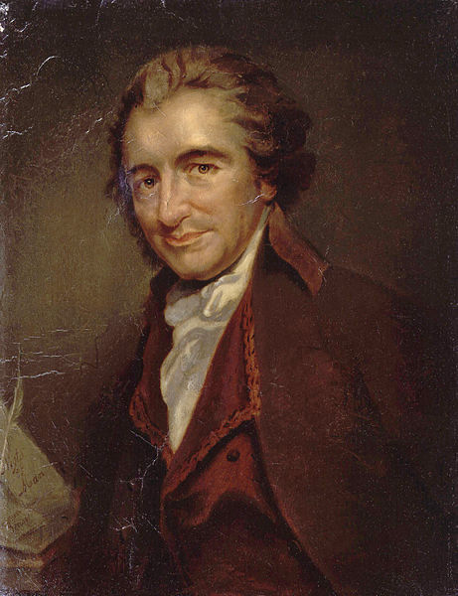

Key Writings Associated With The War
Olive Branch Petition (1775):
Adopted by 2nd Continental Congress after L and C, and Bunker (Breed’s) Hill
Hoped to avoid full-scale war
Rejected by KGIII
Shortly after, KGIII hires Hessian soldiers
Common Sense (1776):
Written by Thomas Paine (T-Paine!)
Stated it was “common sense” for America to break away
Appealed to many Americans “on the fence”
Declaration of Independence (1776):
Multiple parts: idea of government; wrongdoings of the King

Slide 4
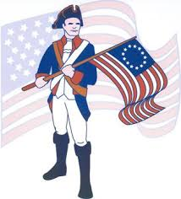
Patriots and Loyalists
Patriots:
Those that favored independence and/or fought for independence
Loyalists:
Americans that stayed loyal to England
Roughly 20% of the population
Many were harassed during the war and had property confiscated
A significant amount fled to England and/or Canada after the war

Slide 5
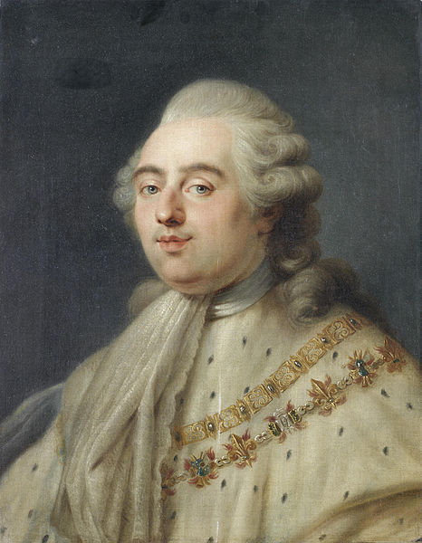
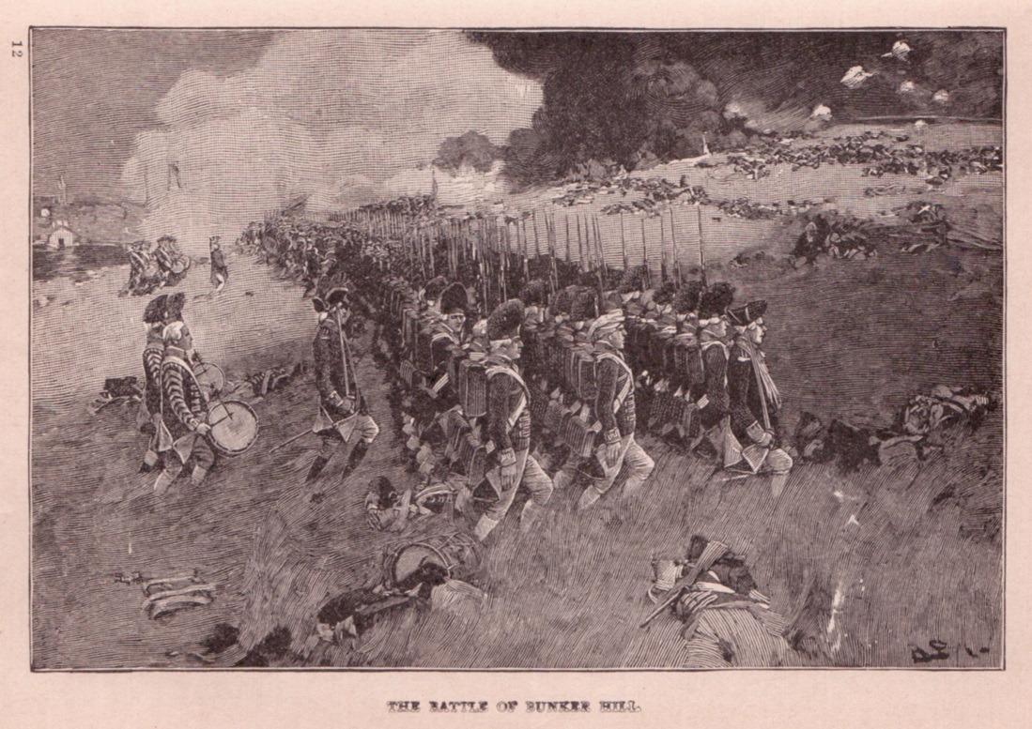
Key Battles During The War
Battle of Bunker (Breed’s) Hill (June, 1775)
Although the Americans lost, there were heavy British casualties
Led to increased morale and belief in military capabilities
Battle of Saratoga (October, 17, 1777)
Americans (Gates) defeat the British (Burgoyne)
This battle results in French aid and an alliance!!!!
Battle of Yorktown (October, 17, 1781)
General Cornwallis surrenders to General Washington
Last major battle of the war

Slide 6
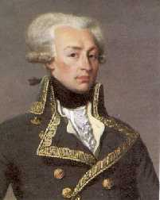
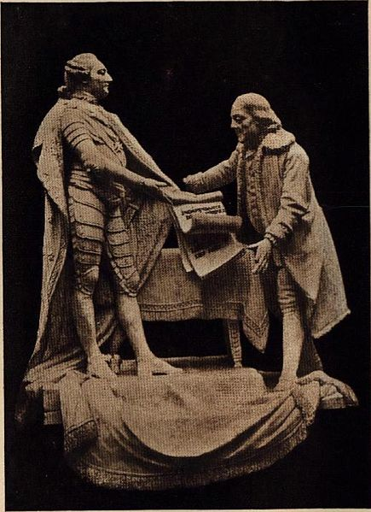
Diplomacy During The War
Benjamin Franklin:
Helped obtain foreign aid, especially French
Marquis de Lafayette (France):
Worked at Washington’s side
Helped with French aid
February 1788:
France recognizes US independence
Soon after, other European countries aid US in the war

Slide 7
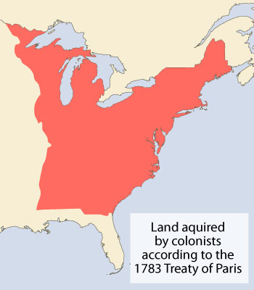
Treaty of Paris (1783)
Officially ends the war
Terms of the treaty:
Britain recognized US independence
Loyalists would not be persecuted
Americans could fish in Newfoundland
US gains land east of Mississippi River
British could collect their debt

Slide 8
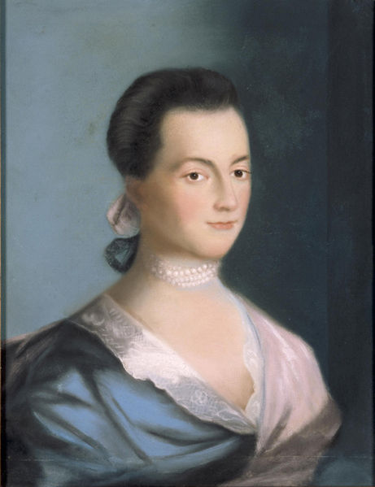
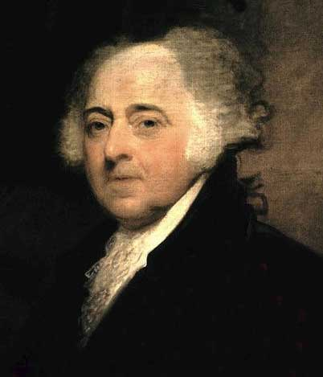
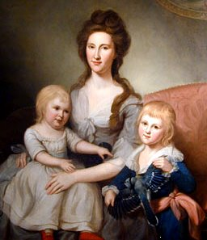
Women and the War
Woops ☹
Don’t forget about us John….
Women’s roles increase while husbands and fathers fight
Many women stayed and worked at military camps
Provide food, caretaking, and laundry
Some disguised as men to fight
Impact of the Revolution on Women:
Abigail Adams’ call to “Remember the Ladies” (1776) is not successful
Married women could still not:
Own property
Get a divorce
Vote
“Republican Motherhood”
Idea that women should raise virtuous children that are good citizens

Slide 9
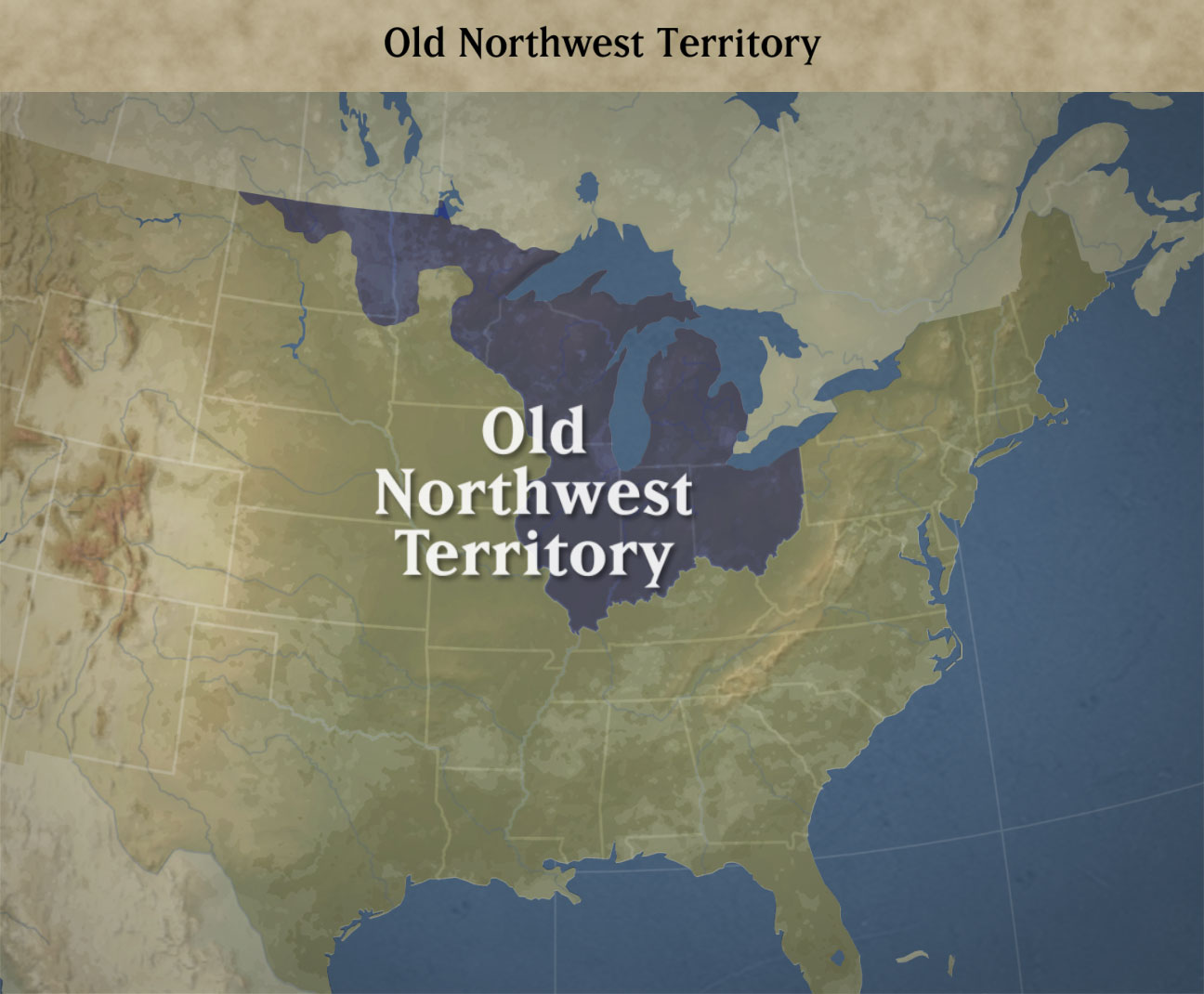
African Americans and the War
During the war:
Roughly 5,000 African-Americans fought on the American side
Some slaves fought on the British behalf, or fled to freedom
Led to resentment from many Southerners
Impact of the Revolution on African-Americans:
“All men are created equal” does not apply
Slavery quickly is abolished in most of north
NW Ordinance (1787) bans slavery in Old NW
Constitution allows for 3/5 Clause and Fugitive Slave Act

Slide 10
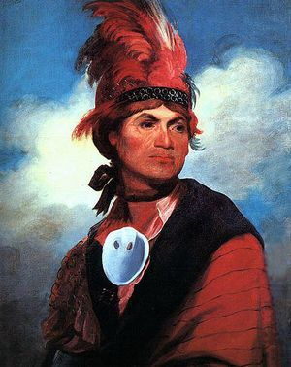

Native Americans and the War
Iroquois Confederacy was divided over who to support
½ the tribes supported the British
Challenges for Native Americans after the war
England no longer prevented expansion -> Americans moved west of Appalachian Mountains
Many Americans resented Natives that fought alongside the British

Slide 11
Past Essay Topics
Analyze the political, diplomatic, and military reasons for the United States victory in the Revolutionary War. Confine your answer to the period 1775–1783 (2010)
Analyze the impact of the American Revolution on both slavery and the status of women in the period from 1775 – 1800 (2004)

Slide 12
Thanks for watching!
Subscribe to APUSHReview.com
Help spread the word
Questions? Comments? Ideas for videos?
Remember to visit APUSHReview.com

